Slide 1



Multimedia & Graphics
Class VI
lab 15

Slide 2
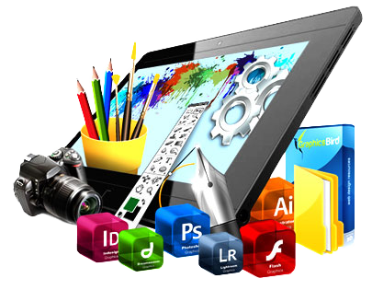
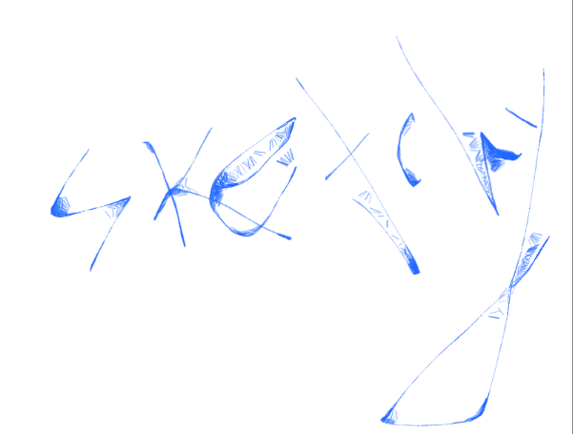
Brush Tools (Sketchy)

Slide 3
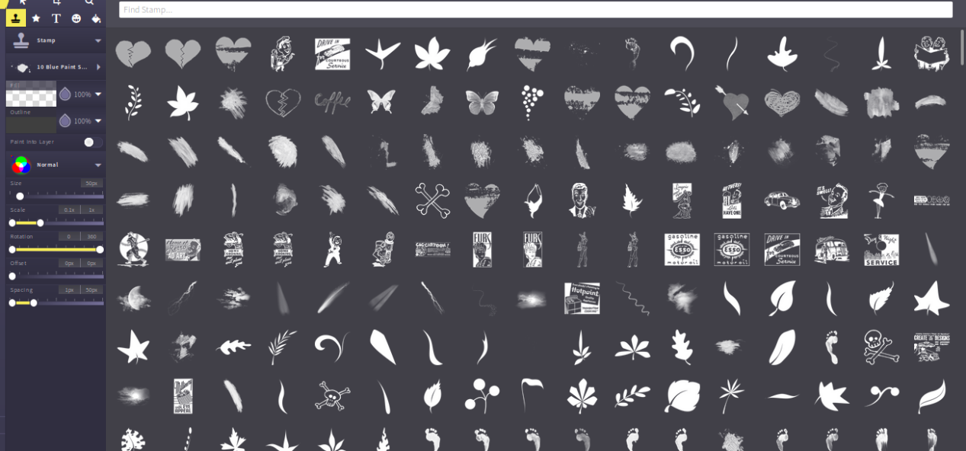
Brush Tools (Stamp)
You can find lots of stamp
under stamp brushes.
Select one of them and use

Slide 4
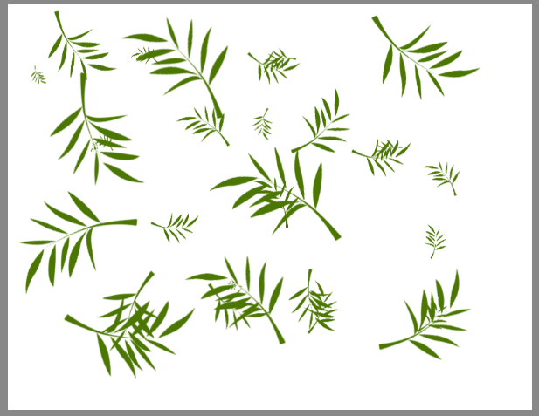
Stamp Tools Example (Leaf)

Slide 5
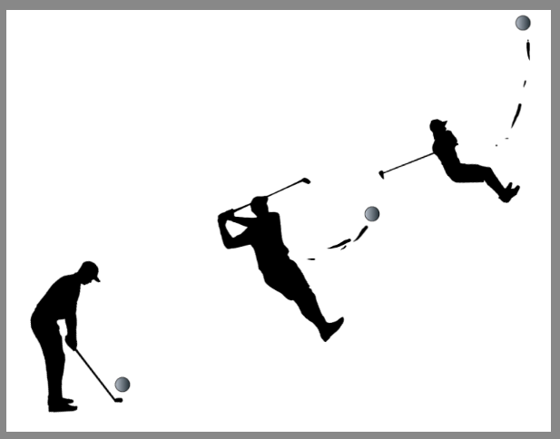
Stamp Tools Example (Golfer)

Slide 6

Shape Tools

Slide 7

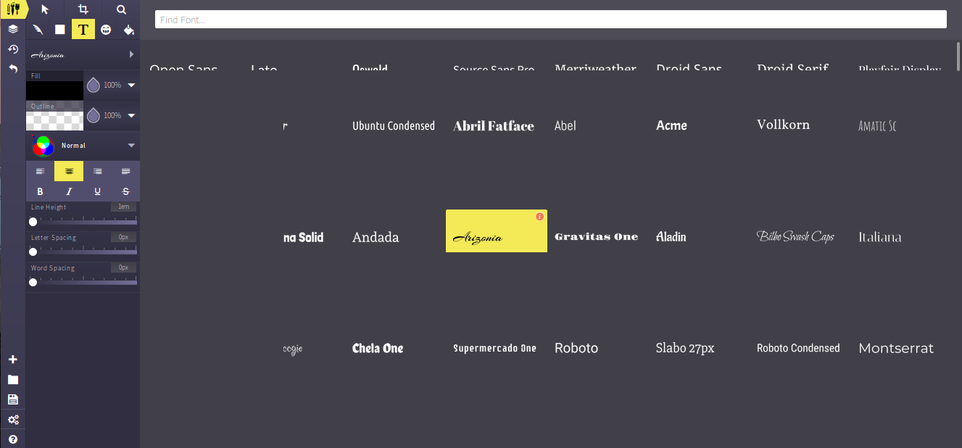
Text Tools

Slide 8



